Slide 1
The Cardiac Cycle
&
Cardiac Output
16 Jan. 2013
Cardiac_Cycle.ppt

Slide 2
The Cardiac Cycle
Heart at rest
  Blood flows from large veins into atria
  Passive flow from atria into ventricles
Atria (R & L) contract simultaneously
  Blood forced into ventricles
Ventricles (R & L) contract simultaneously
  Atrioventricular valves close → “lubb” sound
  Blood forced into large arteries
Ventricles relax
  Semilunar valves close → “dub” sound
Heart at rest
16 Jan. 2013
Cardiac_Cycle.ppt

Slide 3
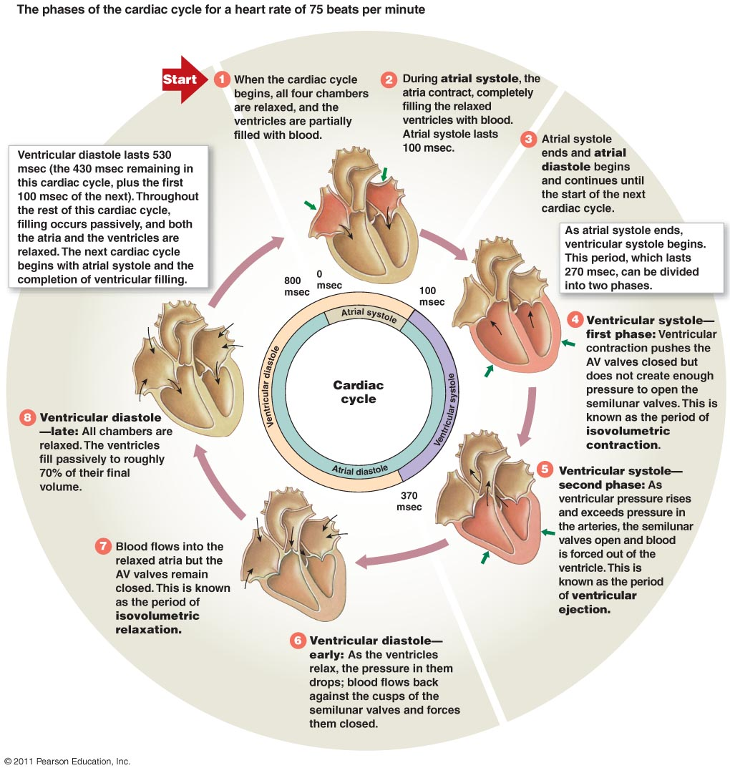
The Cardiac Cycle
16 Jan. 2013
Cardiac_Cycle.ppt

Slide 4
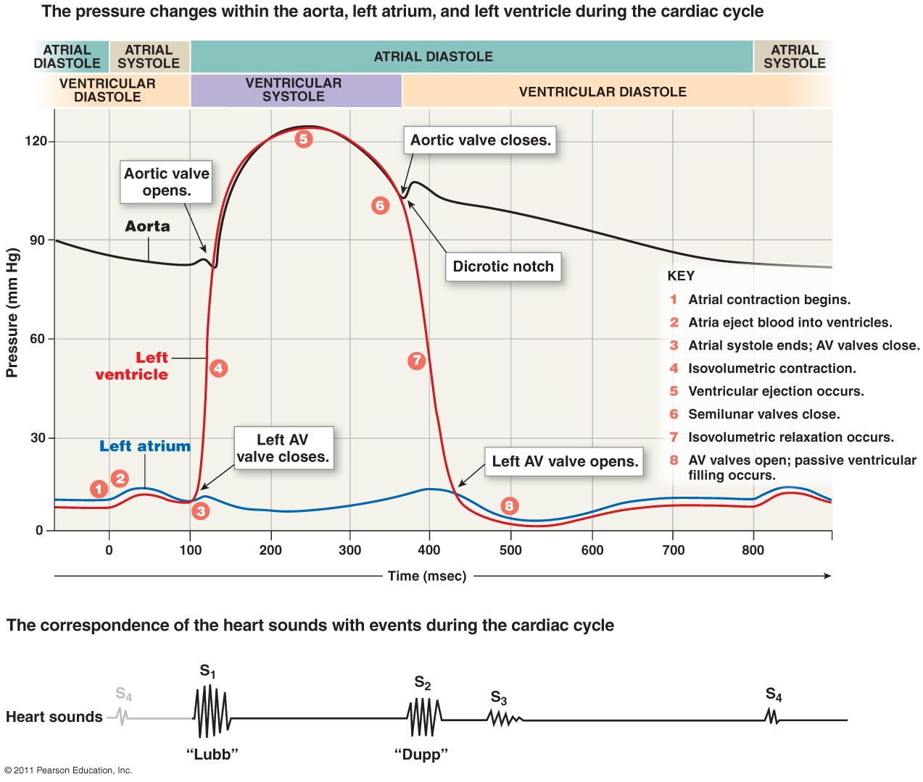
Pressure Changes in the Cardiac Cycle
16 Jan. 2013
Cardiac_Cycle.ppt

Slide 5
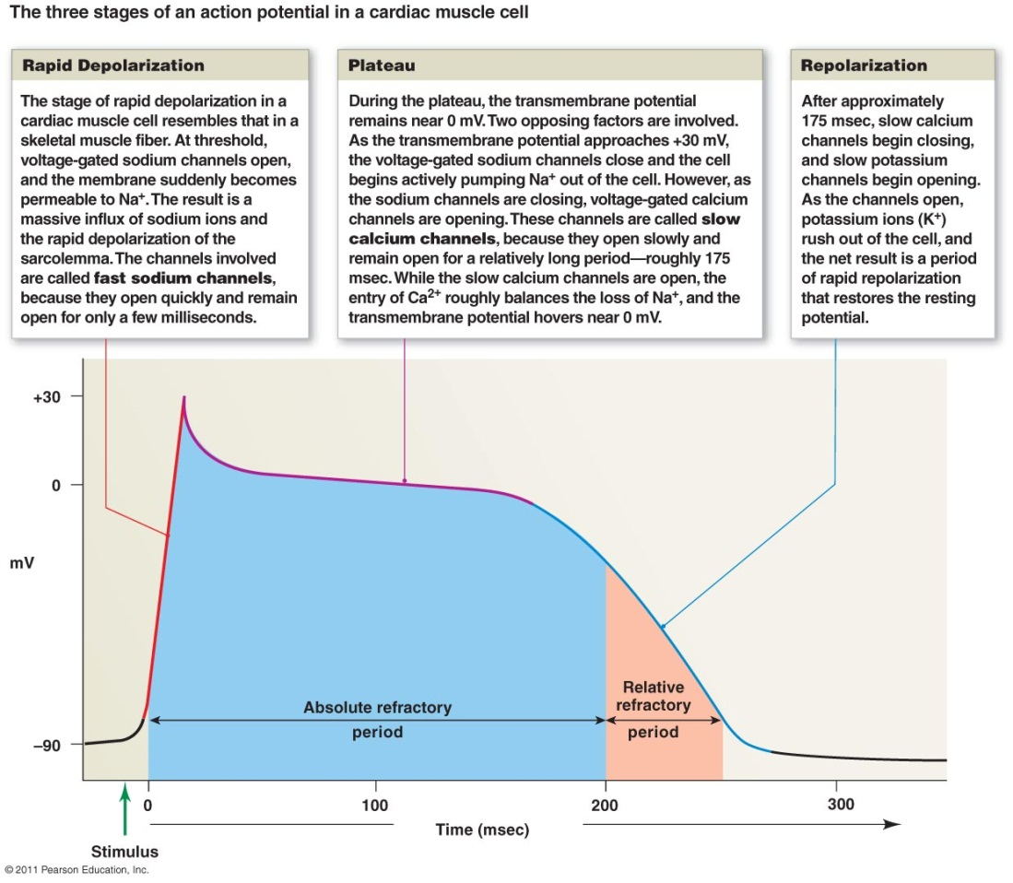
Depolarization in Cardiac Muscle
Voltage-gated fast Na⁺ channels open
  Rapid influx of Na⁺ and depolarization
Release of Ca²⁺ from SR and extracellular space
  Plateau phase: Depolarization prolonged
Opening K⁺ channels & repolarization
16 Jan. 2013
Cardiac_Cycle.ppt

Slide 6
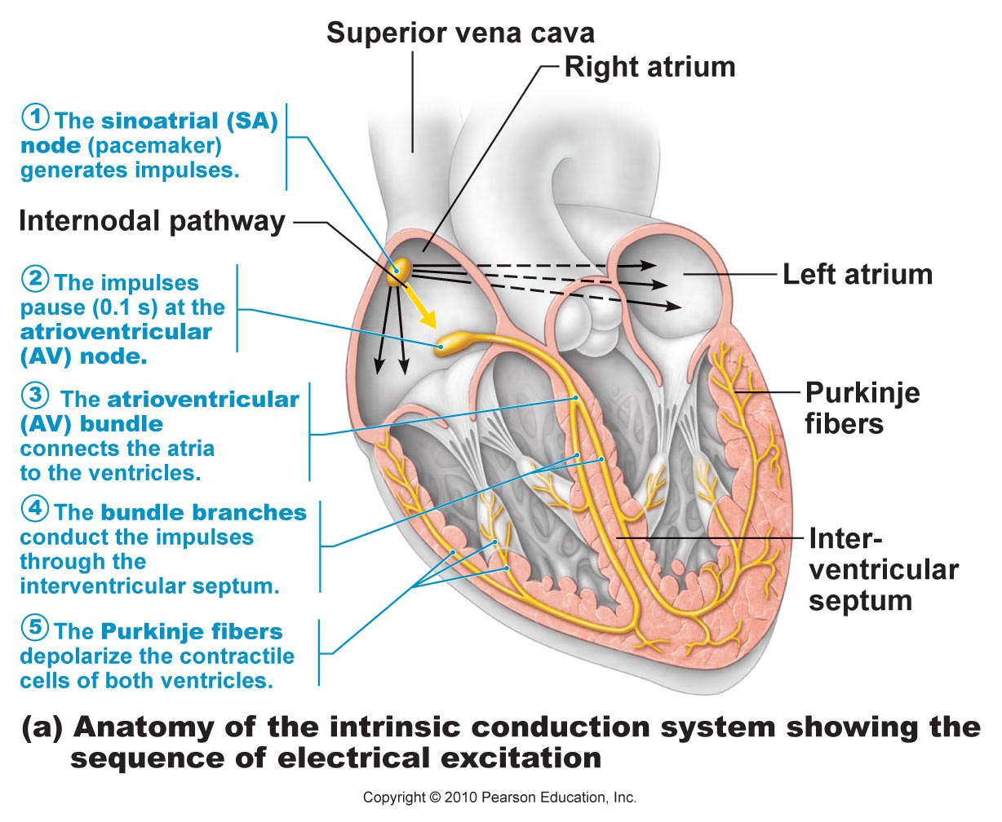
Depolarization and Impulse Conduction
Heart is autorhythmic
Depolarization begins in sinoatrial (SA) node
Spread through atrial myocardium
Delay in atrioventricular (AV) node
16 Jan. 2013
Cardiac_Cycle.ppt

Slide 7
Depolarization and Impulse Conduction
Spread from atrioventricular (AV) node
  AV bundle
  Bundle branches
  Purkinje fibers
16 Jan. 2013
Cardiac_Cycle.ppt

Slide 8
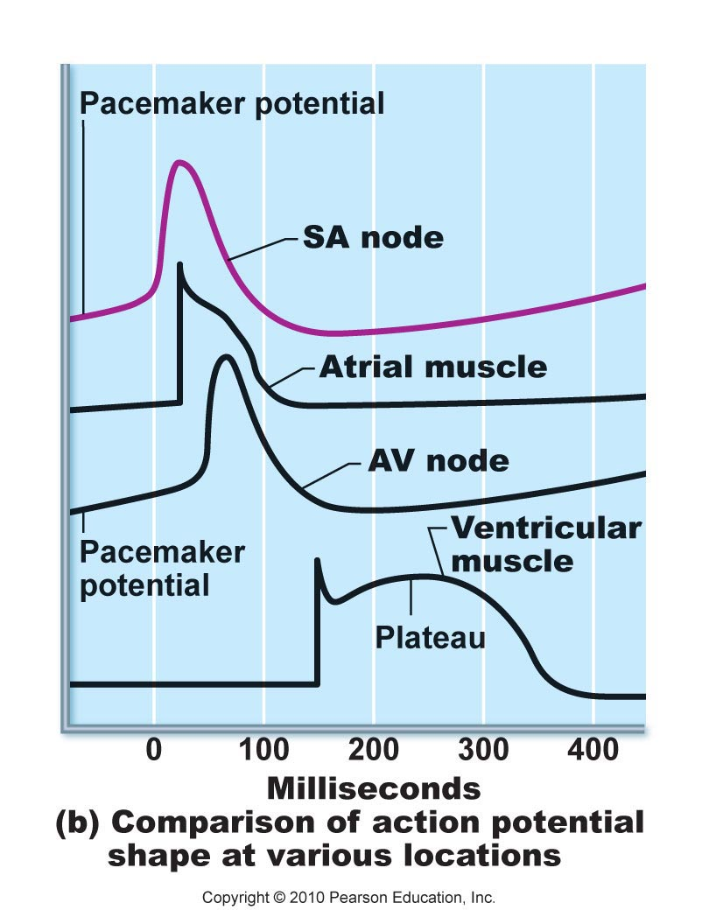
Depolarization and Impulse Conduction
Depolarization in SA node precedes depolarization in atria, AV node, ventricles
16 Jan. 2013
Cardiac_Cycle.ppt

Slide 9
Electrocardiogram
Method developed by Wilhelm Einthoven
  Dutch “Elektrokardiogram” (EKG)
  Now usually “ECG.”
Records electrical events (movements of ions) in heart.
  Variations in electrical potential radiate from heart; detectable at wrists, ankles.
16 Jan. 2013
Cardiac_Cycle.ppt

Slide 10
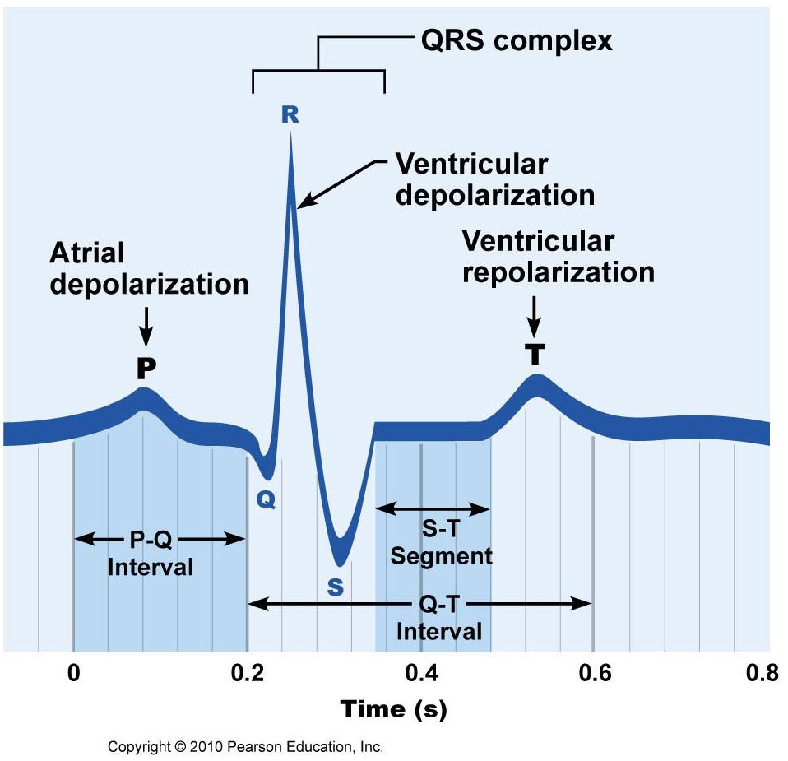
Electrocardiogram
P wave
  Depolarization of atria
  Followed by contraction
QRS complex
  3 waves (Q, R, & S)
  Depolarization of ventricles
  Followed by contraction
T wave
  Repolarization of ventricles
P-Q interval
Q-T interval
16 Jan. 2013
Cardiac_Cycle.ppt

Slide 11
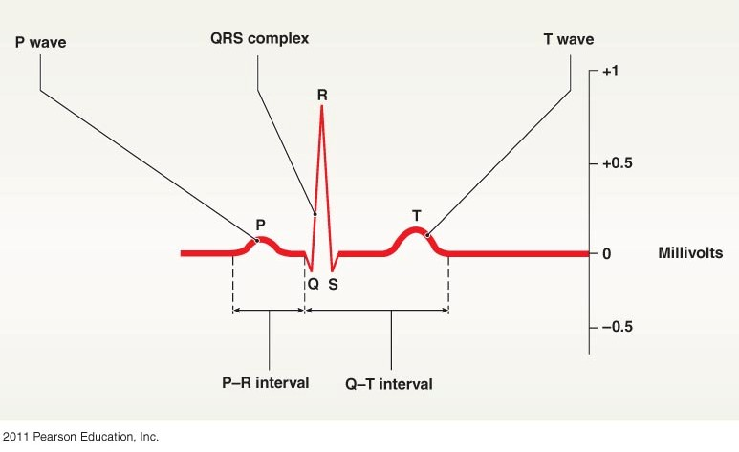
Electrocardiogram
P-Q interval (or P-R)
  Time atria depolarize & remain depolarized
Q-T interval
  Time ventricles depolarize & remain depolarized
16 Jan. 2013
Cardiac_Cycle.ppt

Slide 12
Cardiac Output
Cardiac Output = volume of blood pumped per minute
  Product of Heart Rate (beats/ min.) X Stroke Volume (vol./ beat)
  At rest:
    75 b/ min. X 70 ml/ b = 5250 mL/ min. = 5.25 L/ min.
  During exercise:
    100 b/ min. X 110 ml/ b = 11000 mL/ min. = 11.00 L/ min.
  Extreme exercise:
    120 b/ min. X 125 ml/ b = 15000 mL/ min. = 15.00 L/ min.
16 Jan. 2013
Cardiac_Cycle.ppt

Slide 13
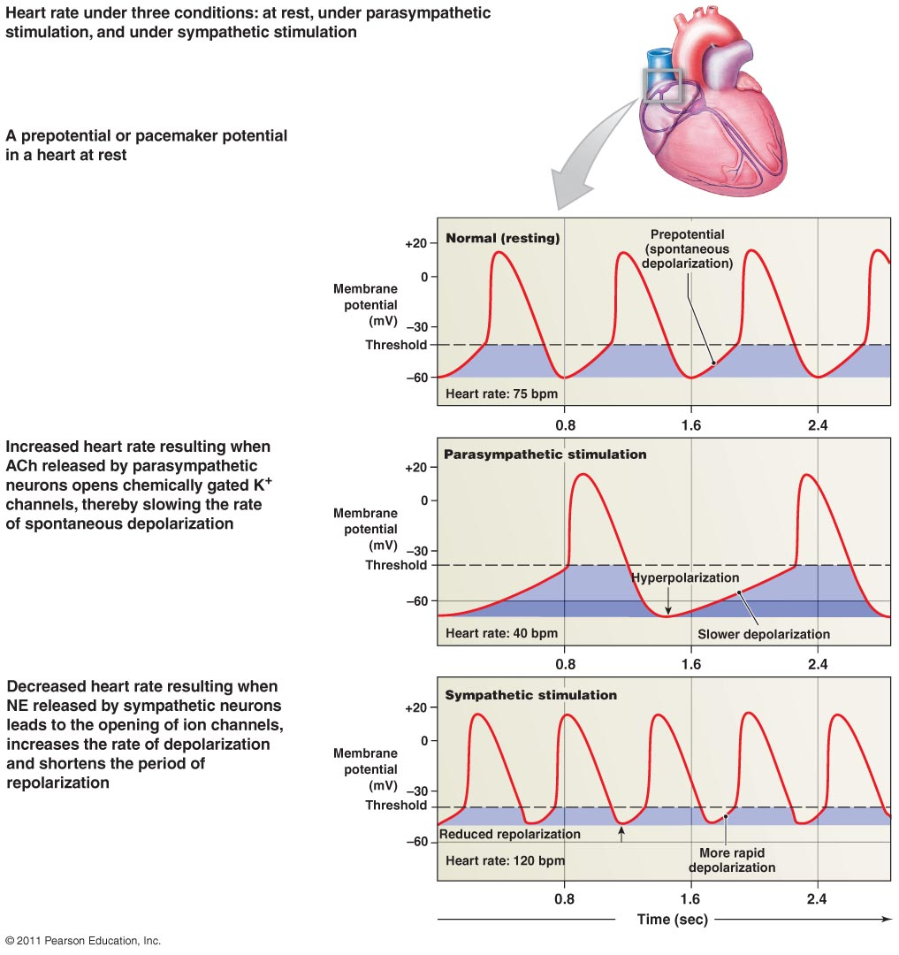
Cardiac Output
Regulation of Heart Rate
  Electrolytes
    Na⁺, K⁺
    Ca⁺
  Hormonal regulation
    Epinephrine
    Thyroxine
  Other factors
    Gender, age, size, health, physical fitness
16 Jan. 2013
Cardiac_Cycle.ppt

Slide 14
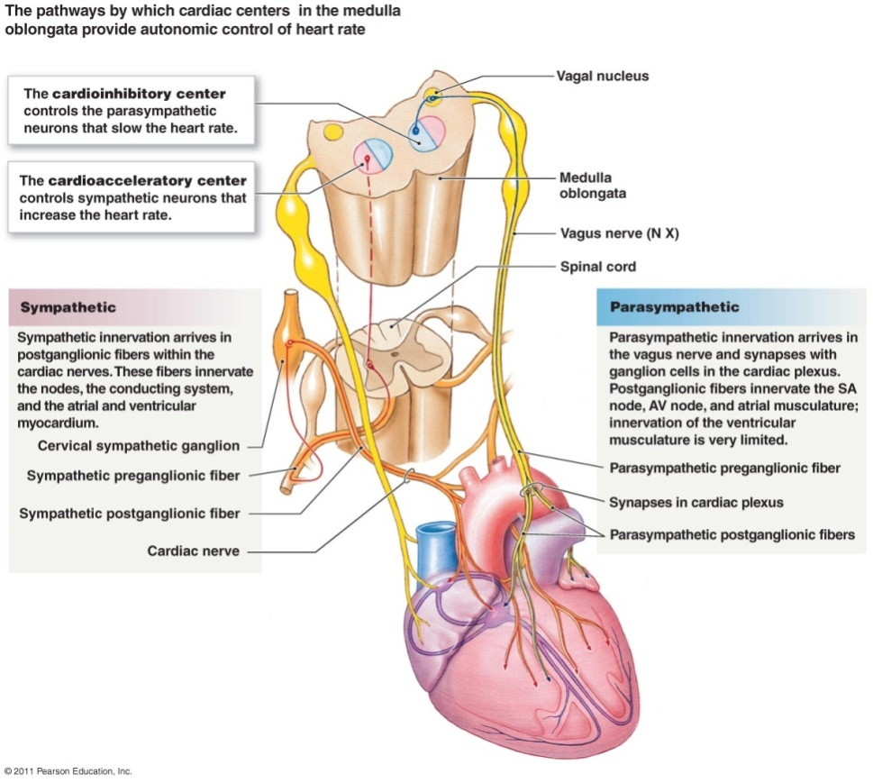
Cardiac Output
Regulation of Heart Rate
  Autonomic regulation
    O₂, CO₂, H⁺ in blood stimulate cardiovascular centers in medulla
    Sympathetic
      CO₂, H⁺ products of exercise, stress
      Activate cardioacceleratory center
      Sympathetic pathway
16 Jan. 2013
Cardiac_Cycle.ppt

Slide 15

Cardiac Output
Regulation of Heart Rate
  Autonomic regulation
    Parasympathetic
      More O₂ in blood during rest
      Activate cardioinhibitory center
      Branch of vagus nerves
16 Jan. 2013
Cardiac_Cycle.ppt

Slide 16
Cardiac Output
Regulation of Stroke Volume
  Change in volume during contraction
  SV = EDV – ESV
    EDV = end-diastolic volume
    ESV = end-systolic volume
16 Jan. 2013
Cardiac_Cycle.ppt

Slide 17
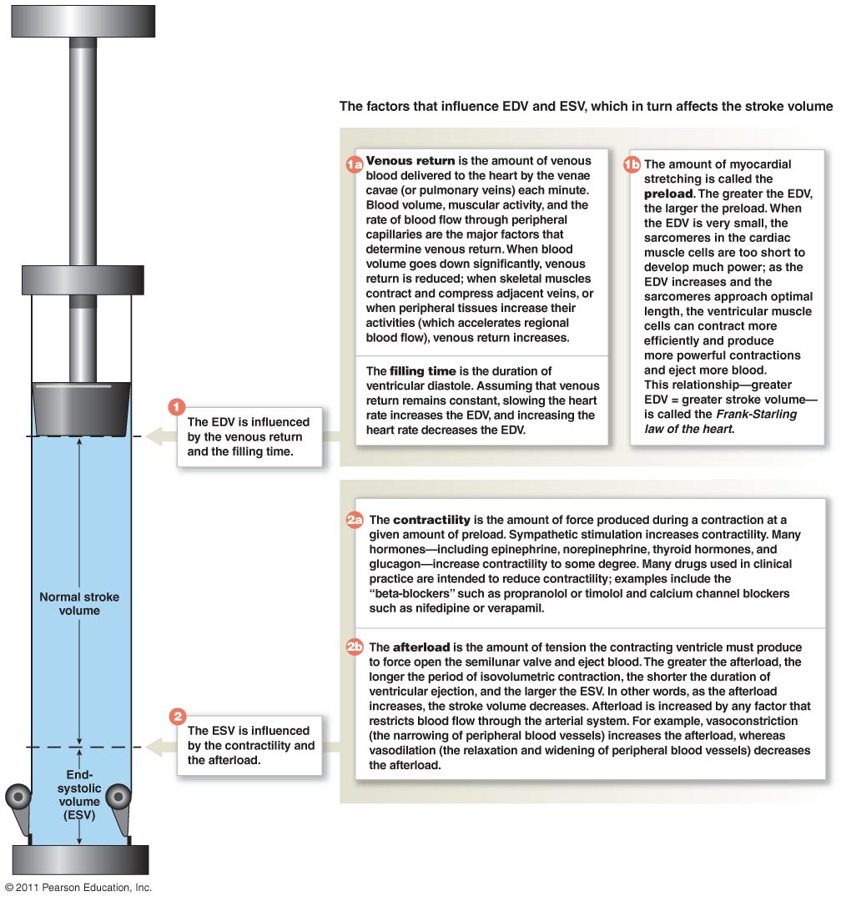
Cardiac Output
Regulation of Stroke Volume
  Preload
  Contractility
  Afterload
16 Jan. 2013
Cardiac_Cycle.ppt

Slide 18
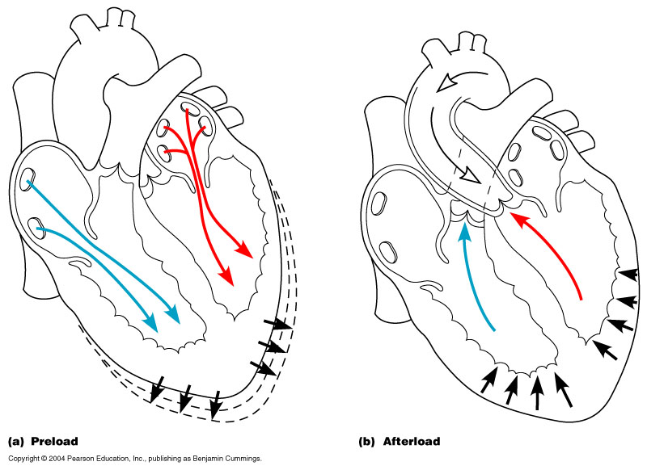
Cardiac Output
Regulation of Stroke Volume
  Preload
  Contractility
  Afterload
16 Jan. 2013
Cardiac_Cycle.ppt

Slide 19
Cardiac Output
Regulation of Stroke Volume
  Preload
    Stretch of muscle fibers at EDV
    Venous return
16 Jan. 2013
Cardiac_Cycle.ppt

Slide 20
Cardiac Output
Regulation of Stroke Volume
  Contractility
    Force of contraction at any given preload.
    Sympathetic stimulation
    thyroxine
    digitalis
    extracellular Ca²⁺
16 Jan. 2013
Cardiac_Cycle.ppt

Slide 21
Cardiac Output
Regulation of Stroke Volume
  Afterload
    Force of blood pressure in large arteries,
    resistance to more blood pumped into those arteries.
16 Jan. 2013
Cardiac_Cycle.ppt

